Slide 1

State of New Hampshire
Department of Health and Human Services
NH Medicaid
Nursing Home Non-Emergency Medical Transportation (NEMT) Monitoring Proposal
April 19, 2023

Slide 2
Process
Work Flow
1) Nursing facility to gather information on NEMT
2) Send Spreadsheet to Medicaid via secure Email
3) Medicaid to forward information to the MCO CEO
4) MCO to investigate and respond to Medicaid
5) Medicaid to respond to Nursing Facilities with case findings
Bi-Weekly meeting to review system status with MCO’s and Nursing Facilities

Slide 3
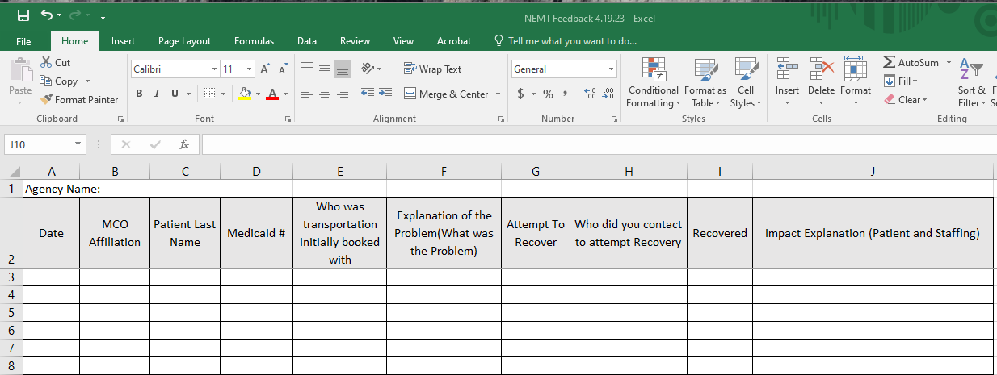
Process
Proposed Spreadsheet
Nursing facility staff will forward on occurrence basis:
The spreadsheets should be sent to NHMEDICAIDNEMT@dhhs.nh.gov. Your initial email will trigger an automated response which will be encrypted and allow you to then send your information securely.
All information will be forwarded to the appropriate MCO for review and response.
Any vehicle safety issues identified will be forwarded by Medicaid Medical Services Unit to Justin Romanello with the NH Department of Safety.

Slide 4
State of New Hampshire
Department of Health and Human Services
  *** This process is intended to make sure significant deficiencies are easily reported and get to the right level of MCO management for systemic remediation; it is not intended to expedite resolution of individual cases or to recover an immediate transportation issue***
CONTACT
Vernon Clough DNP, RN
Administrator Medicaid Medical Services Unit
Vernon.L.Clough@dhhs.nh.gov
603-271-9423
Start date: May 1, 2023

